Slide 1
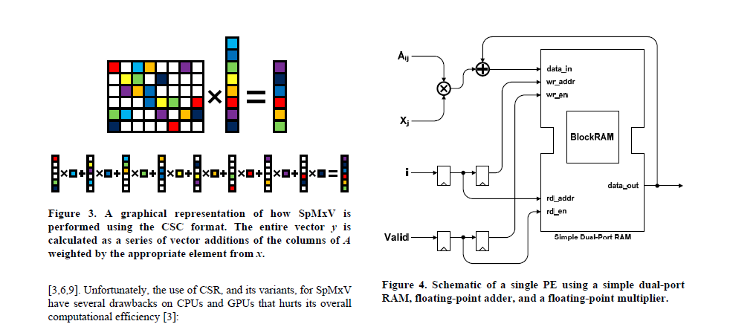
Sparse Matrix Vector Multiplication Part
A Map Reduce like Model
Because reference PE design already has a very good data partition pattern, which decouples PEs and needs no result reduction during a sparse matrix vector multiplication,
we can leverage some techniques from distributed computing !

Slide 2
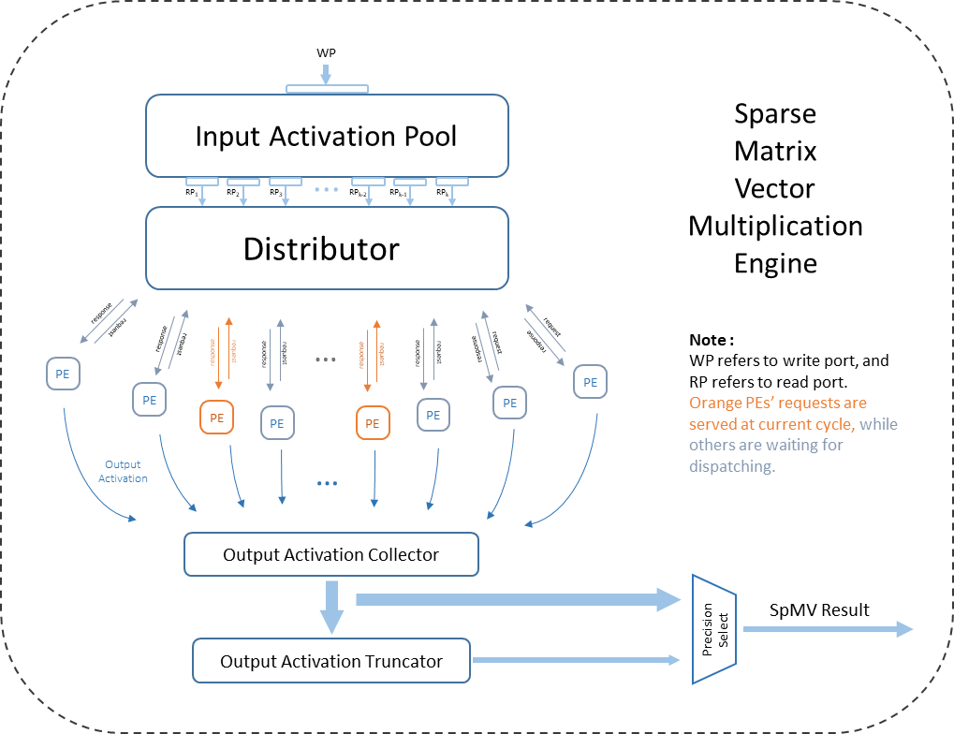
Sparse Matrix Vector Multiplication
Design Overview

Slide 3
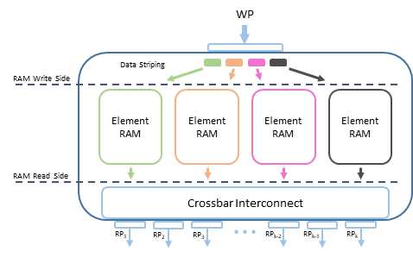
Input Activation Pool Design
Leverage 1 extra features of the problem (may ignored by previous design), that is, input activation is read only when it has been loaded !
The wrapper of Input Activation Pool can be modeled as a Register File, which has k independent read ports and 1 write port. Read ports’ data width is normal, while write port’s can be very wide to improve throughput (Of course, it can also be implemented as a narrow one if it can save area. Actually, the copy of input activation costs a little when compared with weight matrix data)

Slide 4
Input Activation Pool Design
Concrete Implementation:
Element RAMs may have multiple read ports, and have only 1write port to avoid the problem of write arbitration.
Input data are striped to leverage multiple RAMs.
Between output ports and Input Activation Pool top module’s read ports, there is a crossbar interconnect (which means each RP can access any port of any RAM). This setting could let top module RPs share the same address space, thus, could share the ‘read-only’ input.

Slide 5
Simplest distributor :
No distributor, make PEs connected to Activation Pool’s RPs directly.
PE number == RP number
A simple distributor :
Round-robin for each RP
A complex distributor :
Use weighted request, use a priority queue to serve all PEs
Weight can be the load of a PE, that is, leverage the weight matrix information in PE.
A more complex technique :
Use memory access coalesce, which is used by many memory controllers.
Merge the requests which has the same activation request, fetch the activation, and broadcast it to corresponding PEs
Distributor

Slide 6
To Be Discussed :
A precision-variable PE
Supporting different data precision.
Not sure.
A potential design :
Use a 8-bit multiplier, to do 8-bit, 16-bit, 32-bit multiplication, etc.
It may like using a 8-bit CPU to perform high precision multiplication.
16-bit Multiplication:
A * B = (A_{high} * 2⁸ + A_{low}) * (B_{high} * 2⁸ + B_{low})
Use a control register in PE to change the mode. Can change it before a sparse matrix vector multiplication begin. Thus, this kind of flexibility is coarse-grained.
But I think it is enough now, because to tune every parameter is annoying for software guys too ☺

Slide 7
Wrapper Part
Use SpMV to do 3D convolution (Actually, current CNNs’ 3D convolution can be mapped as a 2D convolution over a Matrix Vector Multiplication).
Cooperate with other parts, like non-linear part, Vector Add/Accumulate part (to deal with CNNs or LSTMs).
Need a global dispatcher ? Or hard-wired pipeline ?

